Slide 1
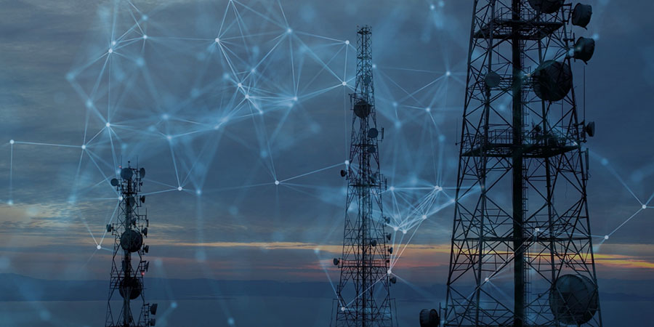
PREDICTION OF TELECOM CUSTOMER CHURN
R.V. GOVERNMENT ARTS COLLEGE,
CHENGALPATTU
BACHELOR OF COMPUTER APPLICATIONS
BY
T.ASHWINI
S.MADHANKUMAR
P.SATHISH
H.SWETHA

Slide 2
INTRODUCTION
Churn prediction is one of the most popular big data use cases in business . it consists of detection customers who are likely to cancel a subscription to a service .
Churn is a problem for telecom companies because it is more expensive to acquire a new customer than to keep your existing one from leaving .

Slide 3
PROJECT OBJECTIVE
To predict customer churn .
Highlighting the main variables/factors influencing customer churn .
Use various ML algorithms to build prediction models , evaluate the accuracy and performance of these models .
Finding out the best model for our business case & providing executive summary .

Slide 4
DATASET DESCRIPTION
Source dataset is in CSV format .
Dataset contains 1142 rows and 22 columns .
There is no missing values for the provided input dataset .
Churn is the variable which notifies whether a particular customer is churned or not .
We will be developing our models to predict the problems in telecom .

Slide 5
CHURN PREDICTION MODEL
Training data
UPDATE
BUILD
Model
Real
INDEPENDENT
PREDICT
TEST
Testing data
TEST=OK

Slide 6
EXPLORATORY DATA ANALYSIS
Data visualization using seaborne and matplotlip .
Exploratory data analysis(EDA) is an apporach to analyze datasets & to summarize their main characteristics , often with visual methods .
The statistical method can be used or not, but primarily EDA is for seen what the data can tell us beyond formal modeling or hypothesis.

Slide 7
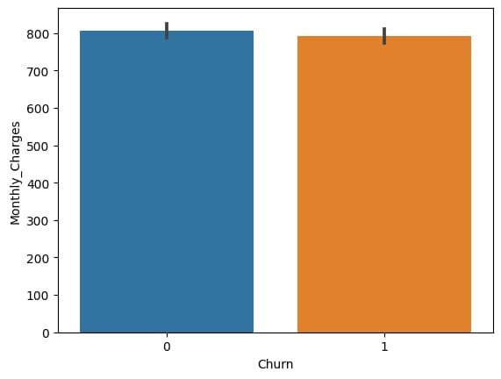
BAR GRAPH
Plot shows that the users from the data
are likely to be continuning their subscription plan.
Y axis denotes the monthly charges and X axis denotes the churn.
(male=0,female=1)

Slide 8
ACCURACY OF VARIOUS MODEL
KNN:
The k-nearest neighbors algorithm is a simple , supervised machine learning algorithm that can be used to solve both classification and regression problems.
SVM:
A support vector machine is a type of deep learning algorithm that performs supervised learning for classification or regression of data groups.
MODELS | ACCURACY
KNN | 0.85%
SVM | 0.51%

Slide 9
HOW TO REDUCE CUSTOMER CHURN
Lean into your best customers .
Be proactive with communication .
Define a roadmap for your new customers .
Offer incentives .
Ask for feedback often .
Analyze churn when it happens .
Stay competitive .

Slide 10
CONCLUSION
The importance of this type of research in the telecom market is to help companies make more profit .
It has become known that predicting churn is one of the most important sources of income to telecom companies .
Hence , this research aimed to build a system that predicts the churn of customers telecom company .

Slide 11
THANK YOU

